Slide 1

Fresher Program
Group Member
Project Name
Opening Vacancies
Tran Thanh Nhut
Tran Thien Khiem
Mentor : Tran Quoc Huy
1

Slide 2





Working Environment
Language C#
CSS
Sharepoint 2013
Visual Studio 2013
2

Slide 3
Agenda
Introduction and Main Function
Demo
3

Slide 4
Web Part
Application Page
User Interface
4

Slide 5
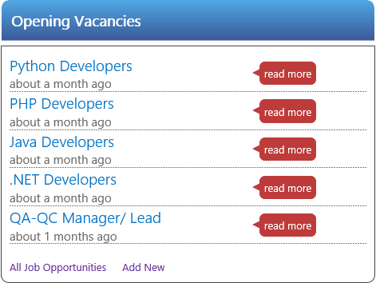
Opening Vacancies
Get data from list in sharepoint
Display limit row
Sort by date
Function
Read More
All Job Opportunities
Add New
5

Slide 6
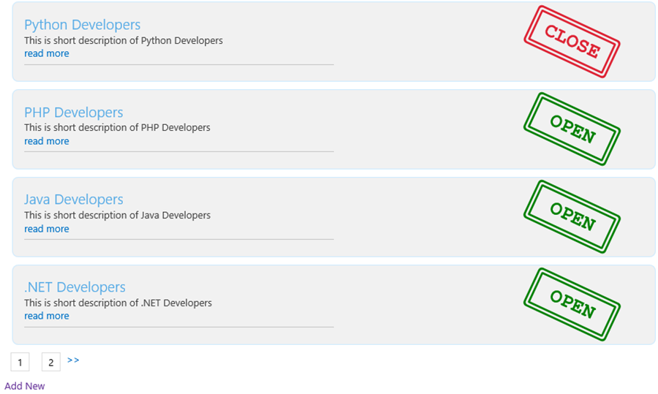
Opening Vacancies
All Job
Show All Vacancies
Function
Read More
Add New
6

Slide 7
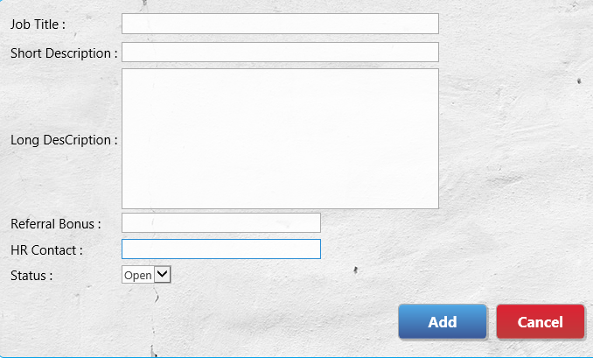
Opening Vacancies
Add New
Add new Vacancies
7

Slide 8
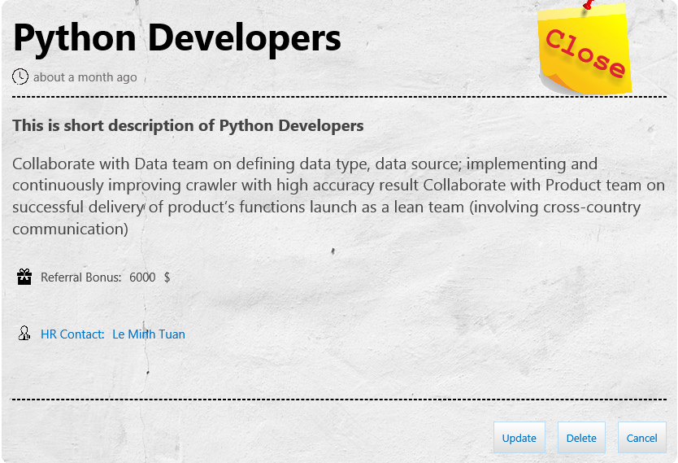
Opening Vacancies
Job Detail
Show information job
Function
Update
Delete
Cancel
8

Slide 9
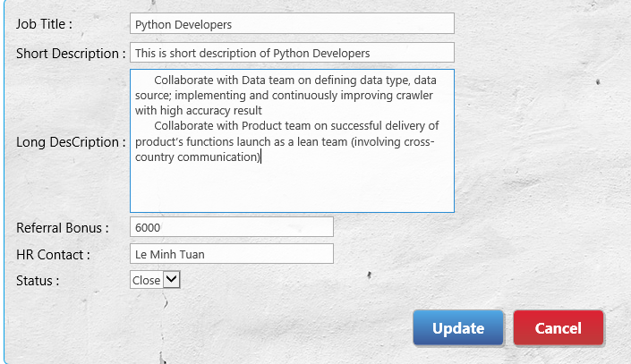
Opening Vacancies
Update
Update Vacancies
9

Slide 10
Demo: Login by User Group
Demo: Login by HR Group
DEMO
10

